Slide 1
Welcome to our English class .
English 5

Slide 2
Guesing the jobs

Slide 3
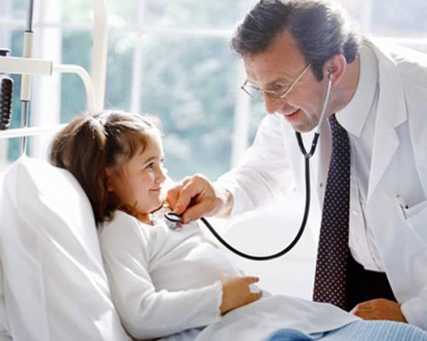
He is a doctor

Slide 4
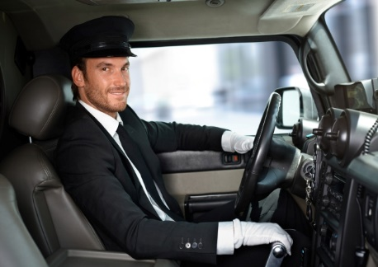
He is a driver

Slide 5
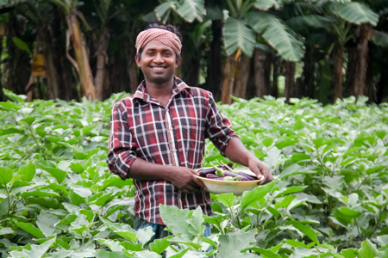
He is a farmer

Slide 6
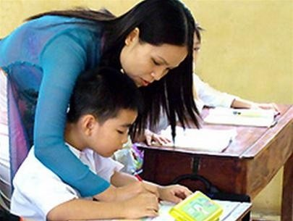
She is a teacher

Slide 7
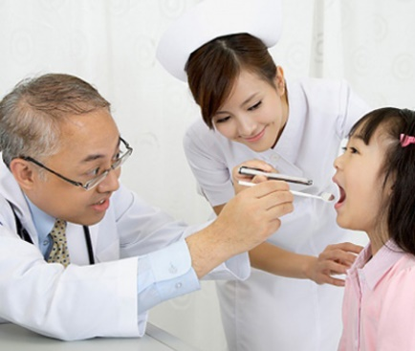
He is a dentist
Notes:
7

Slide 8
They are nurses
Notes:
8

Slide 9
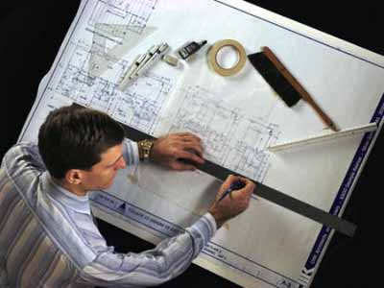
He is an architect
Notes:
9

Slide 10
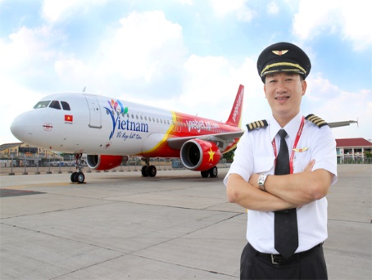
He is a pilot

Slide 11
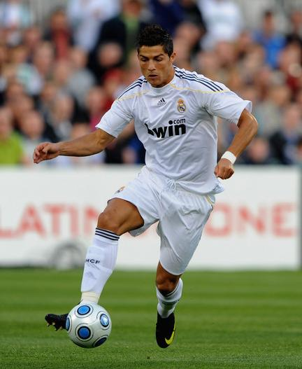
He is a footballer

Slide 12
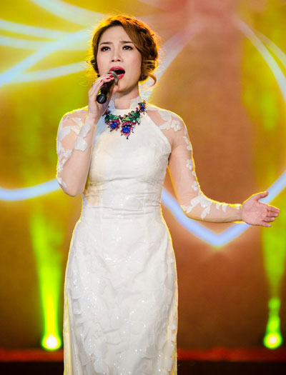
She is a singer

Slide 13
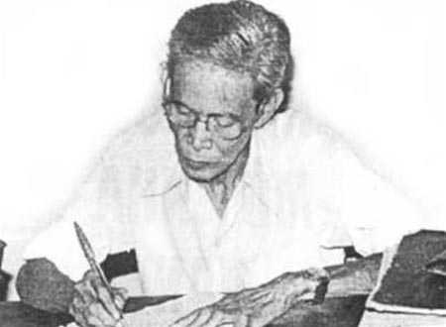
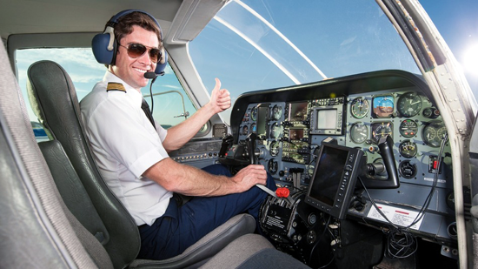
Matching words with pictures then read aloud
a. fly a plane
b. design buildings
c. write stories
d. look after patients
2
1
3
4

Slide 14
look after
chăm sóc
patient
bệnh nhân

Slide 15
look after patients

Slide 16
design
thiết kế
buildings
những tòa nhà

Slide 17
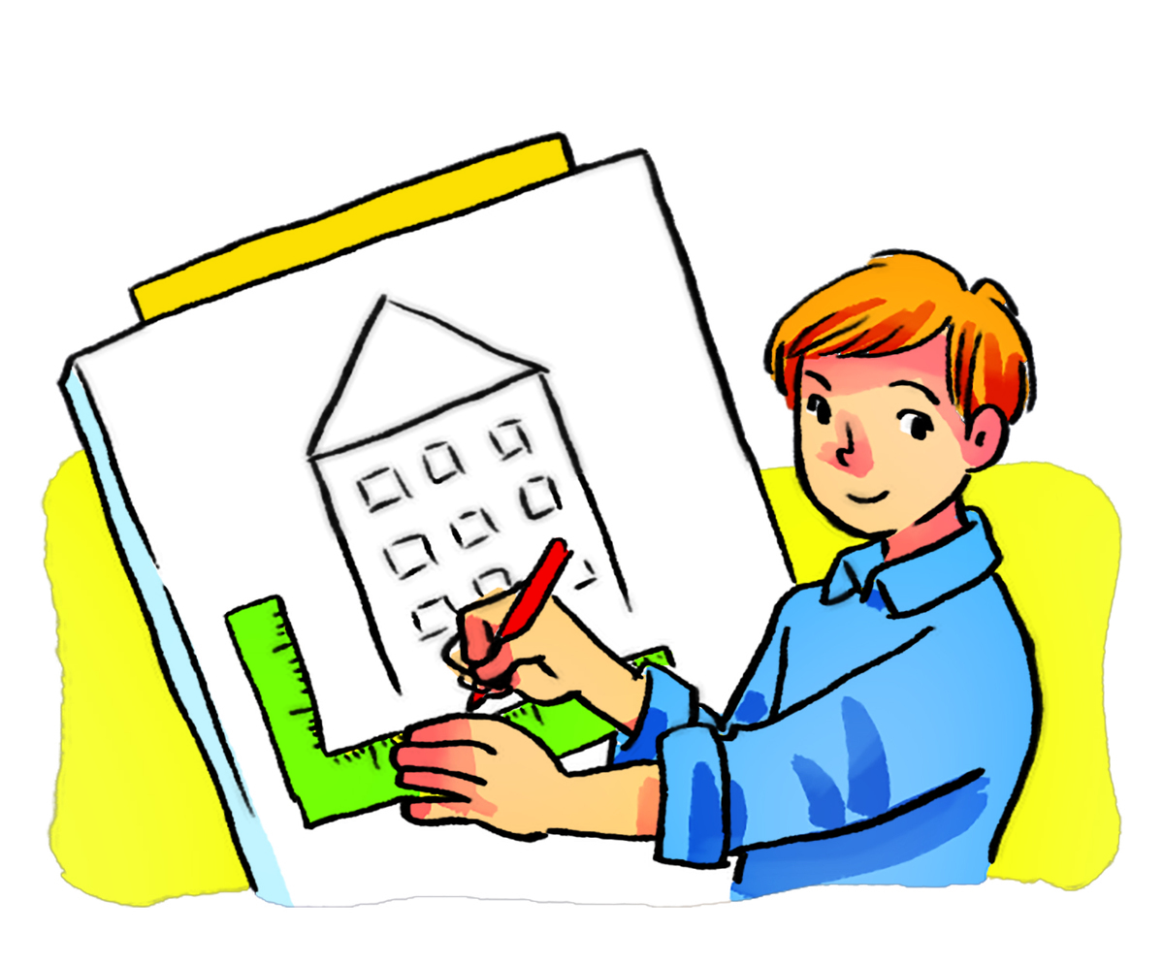
design buildings

Slide 18
write stories for children

Slide 19
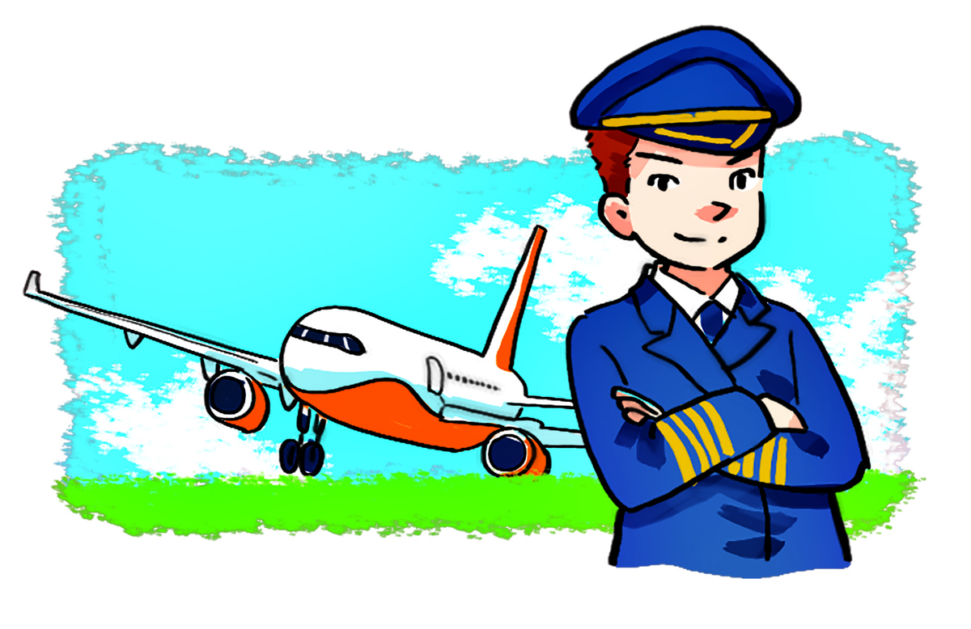
fly a plane

Slide 20
Vocabulary
look after patients
write stories for children
fly
a plane
design buildings

Slide 22
True/False sentences
1. Mai would like to be a writer in the future.
True
2. Mai would like to sing.
False
3. Linda would like to be a writer too.
False
4. Linda would like to fly a plane.
False

Slide 23
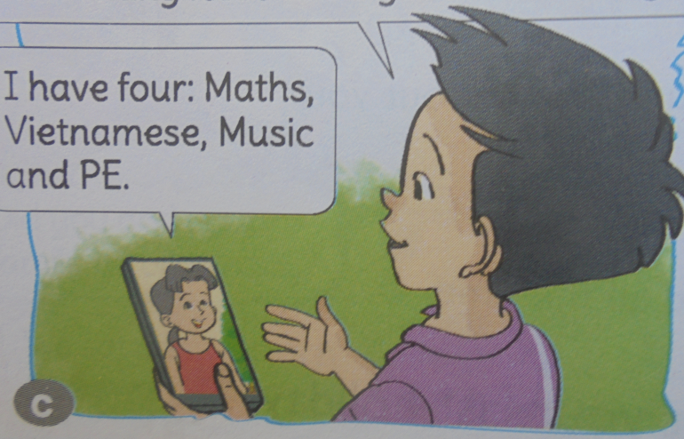
SENTENCES
Why would you like to be a pilot?
Because I’d like to fly a plane.
Notes:
Why not?
Why wouldn’t you like…?

Slide 24
Let’s listen!

Slide 25
Let’s play a game : Do a crossword
1
P I L O T
2
D E N T I S T
3
F O O T B A L L E R
D O C T O R
4
5
A R C H I T E C T
6
F A R M E R
7
D R I V E R
DOWN
: TEACHER

Slide 26
HOME LINK
- Practise asking and answering about the future job and the reason why.
- Prepare new lesson:
Unit 15- Lesson 3

Slide 27
Thanks for your attendance
Good bye.

Slide 28
1.He flies a plane . He is a …
pilot
HOME

Slide 29
2.You have a toothache . You should go to the …
dentist
HOME

Slide 30
3.He likes playing football .He’d like to be a ………… in the future.
footballer
HOME

Slide 31
4.You have a fever . You should go to the ………
doctor
HOME

Slide 32
5.He designs buildings. He is an……….…
architect
HOME

Slide 33
6.He works on a farm . He is a ………….…
farmer
HOME

Slide 34
7.He drives a taxi .
He is a ……..…
taxi driver
HOME

